Slide 1

Crop Production Analysis in India
Notes:
Line spacing + Page numbers

Slide 2



Introduction
01
The agricultural sector in India plays a critical role in ensuring food security for a growing population. However, traditional farming methods are often resource-intensive and struggle to keep pace with rising demand. This presentation explores the potential of big data analytics to revolutionize crop production in India. We'll analyze a vast dataset on crop production spanning several years, aiming to predict future yields and identify key factors influencing crop success. By leveraging big data, we can empower Indian farmers to make informed decisions and optimize their agricultural practices for a more sustainable and abundant future.

Slide 3

Details Of Data The data for this analysis would encompass a vast dataset on crop production in India over several years. This dataset could include information from various sources: State name, District name, Crop year, Season, Area, Production

Slide 4

Main KPIs
Sum of production by year
Average yield and sum of production
sum of production by state name
sum of production by state name and season
sum of area
Sum of production

Slide 5
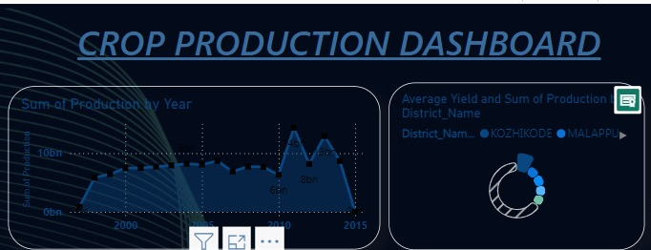
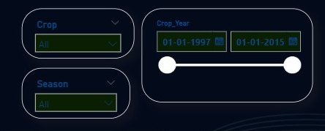
My Dashboard

Slide 6
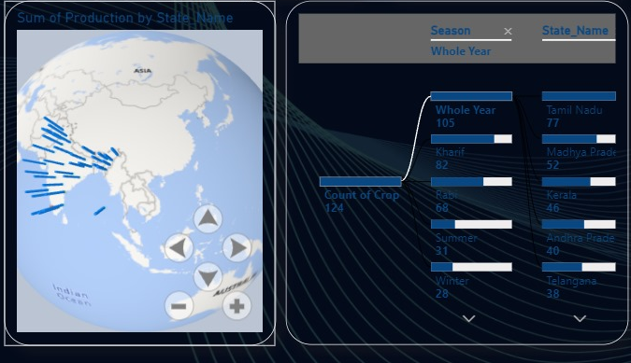
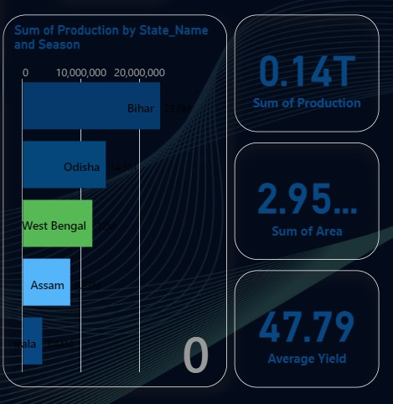
My Dashboard

Slide 7

Thank you

